Slide 1


Success Classifier – Phase I
Exploratory Data Analysis (Demographics)
By: Dhruv Singh
11.19.2021

Slide 2
Answer the question: Who are our customers?
Ph
Phase I: Objective
Answering this question will enable better targeting of services, in subsequent phases

Slide 3
Overview
Overall objective of Success Classifier project: to measure Workforce Training program efficacy
Pilot analysis focus: Local programs, January 1, 2011 to August 5, 2021.
Data pulled on 8.05.2021
Source: DC Networks, Maryland Custom Report.
Programs covered: 8 locally funded programs, complete list in appendix

Slide 4
Summary: Approach
Analysis comparing enrollment numbers vs. employment rate
Categorical variables (race, gender): includes time trends
Numeric variables (age, education): aggregates
Disclaimer: Excludes non-response data, choose not to disclose data, non-binary gender data, multiracial categories, age below 14, and education levels below the 9th grade

Slide 5
Summary: CY 2011 – CY 2021 Findings
23,084 Total Unique Enrollments
6,588 Total Unique Employment, 28.5% success rate
Lowest enrollments in 2014 (1,025 total)
Peak enrollment in 2019 (4,027 total)
Peak enrollment in 2019, helped employ 38.5% of customers
1,342 Unique Employment (age 20-24)
4,988 Unique Enrollments (age 20-24), 26.9% success rate
Females enrolled in lower absolute numbers than males,
Achieved higher employment rates, between 30-40% between 2015-2020

Slide 6
Summary: CY 2011 – CY 2021 Findings
African Americans above 90% of all customers.
Employment rate below 35%, compared with rates over 60%
US Citizens largest category by citizenship
Also helped US Permanent residents and illegal aliens achieve employment rates of over 50%
Most customers: some high school to some technical training
Customers with associates degree or beyond: more successful in obtaining employment

Slide 7
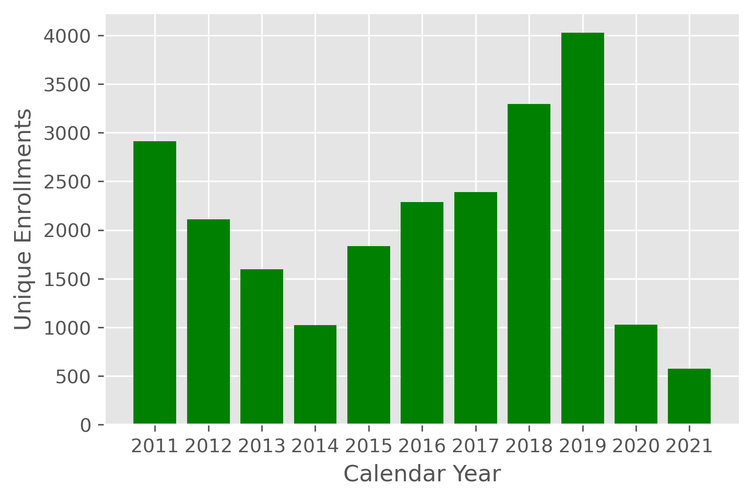
Program Enrollments, Jan ’11- Aug ’21
The decreased services in 2014 may be attributed to agency administration change
The increase in 2018 and 2019 likely resulted from increases
funding, and new programs such as DCIA

Slide 8
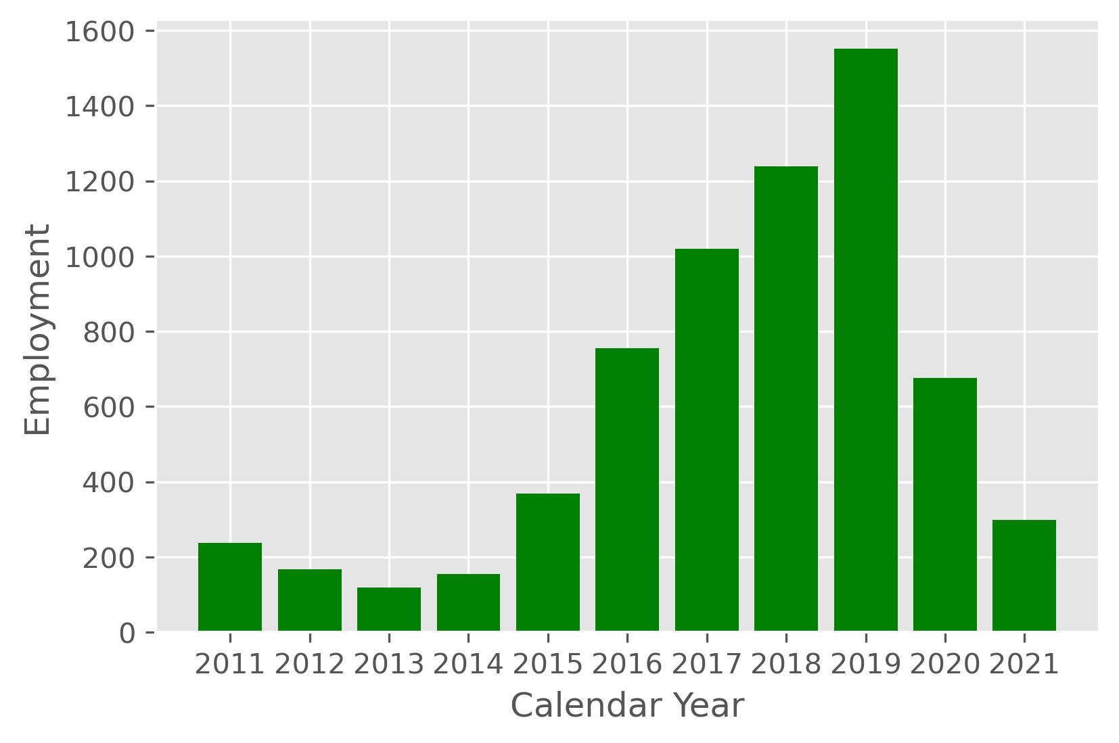
Successful Employment, Jan ’11 – Aug ’21
Increased enrollment resulted in increased employment
At its peak in 2019, there were 1,551 employments for every 4,027 enrollments
An employment rate of 38.5%

Slide 9
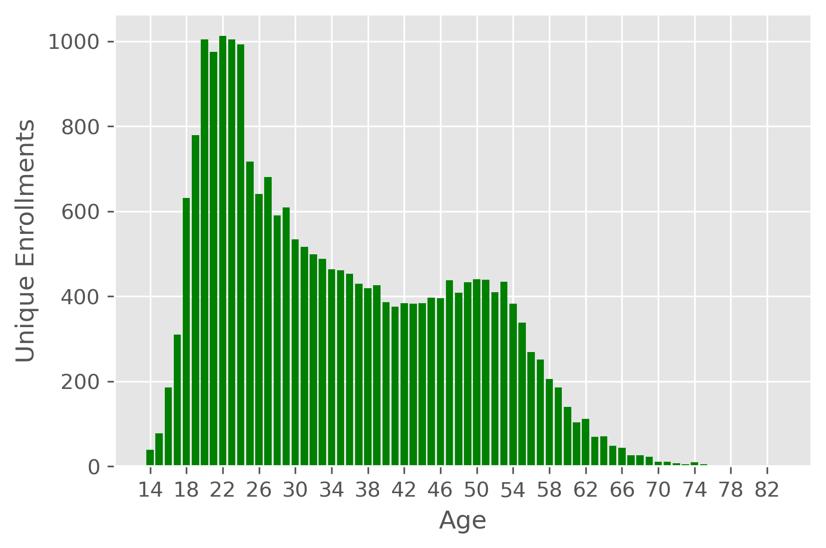
Enrollments by Age: CY 2011-2021
The largest served age group is between 20-24 years of age
There is a slight bump in enrollments around age 50
There are few people below 14 served.
Those that were in the data have been excluded

Slide 10
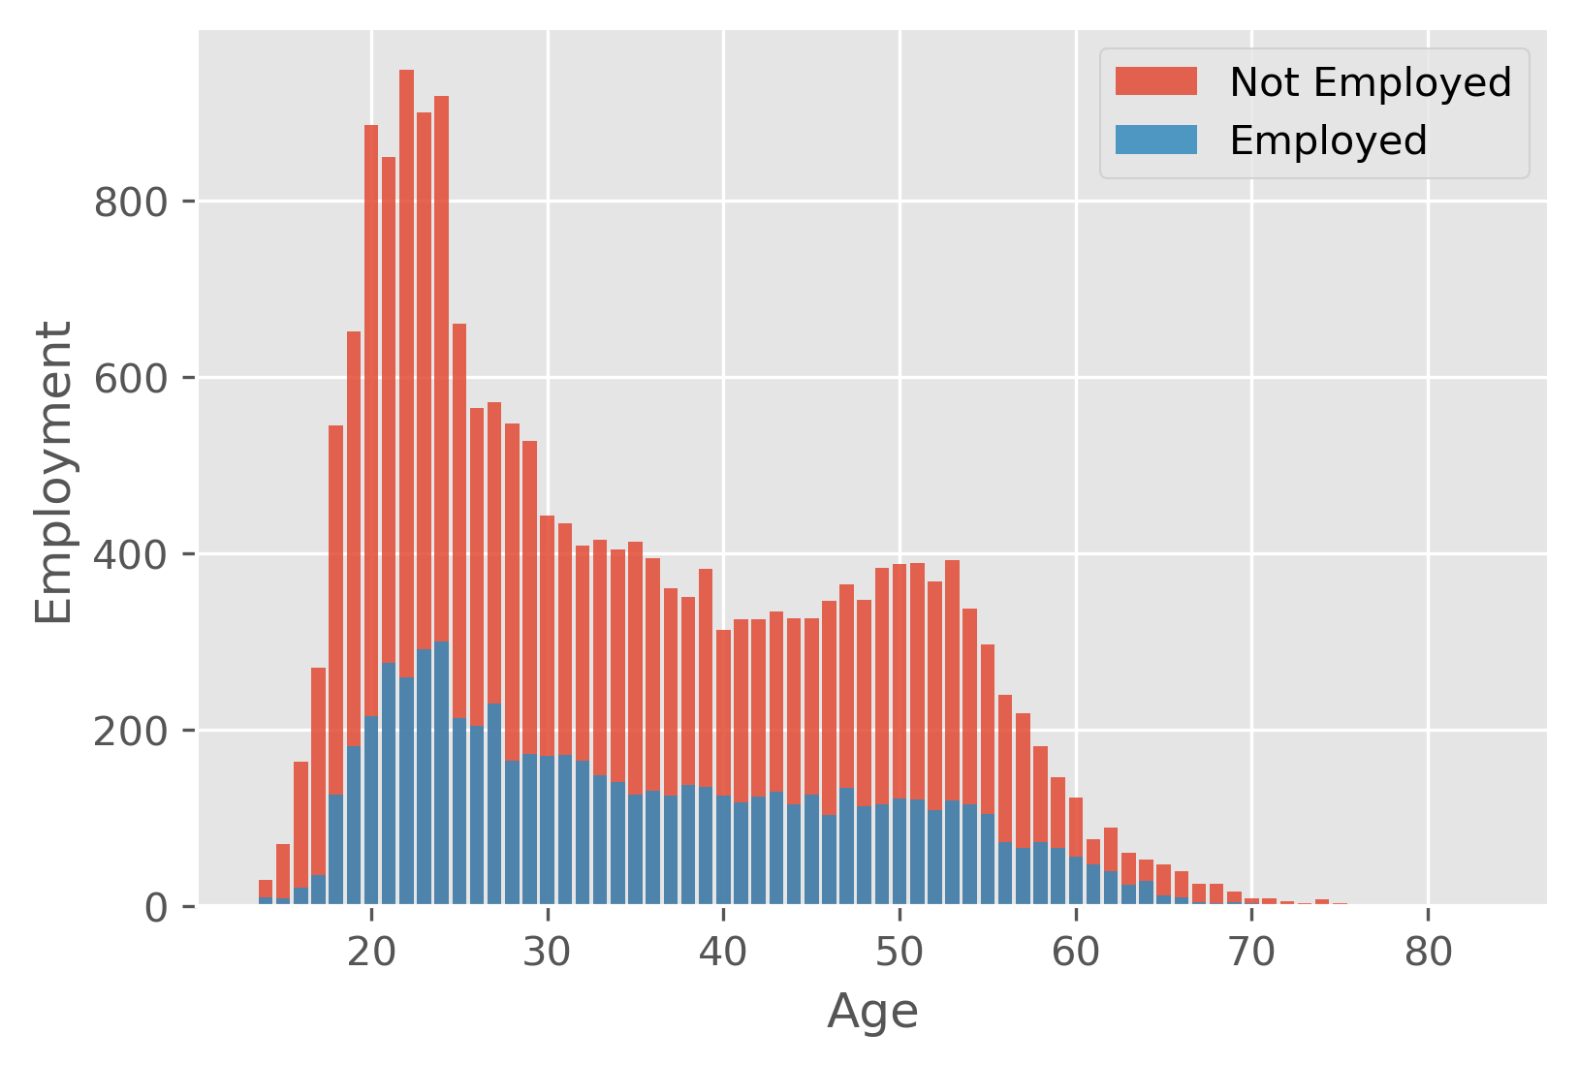
Employment by Age, Jan ’11 – Aug ’21
20-24 year age range, employed 1,342 people for 4,502 unemployed individuals
The ratio of employed to unemployed participants age 20-24 was 1:3
49-53 year age range, 588 employed for 1,921 unemployed
Employed to unemployed ratio of 1:3 for participants aged 49-53

Slide 11
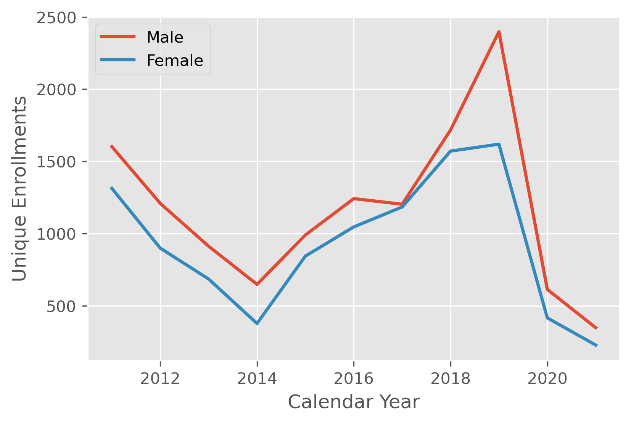
Enrollments by Gender, Jan ’11 – Aug ’21
Genders track a similar trend, with only a marginal separation in values.
The biggest gap appears in 2019

Slide 12
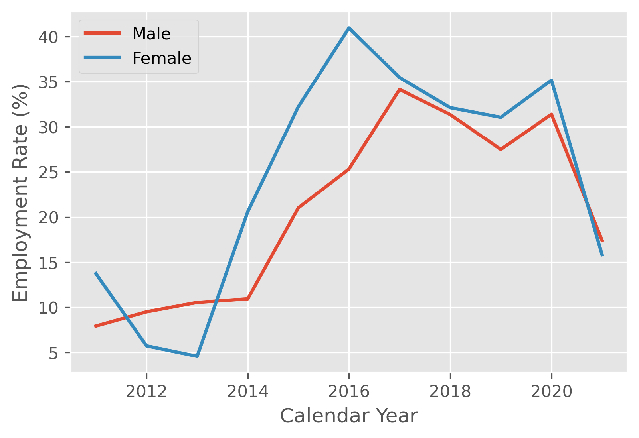
Employed % by Gender, Jan ’11 - Aug’21
Females are consistently more successful in obtaining employment than males, following 2013
Employment rates of females are between 30-40% from 2015-2020
There is a decline in employment rates post-2020, due to COVID-19

Slide 13
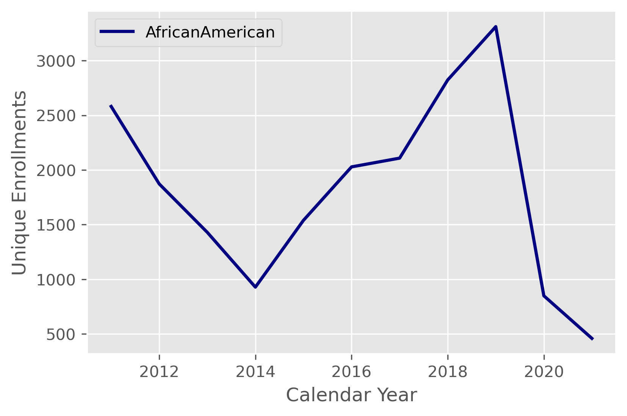
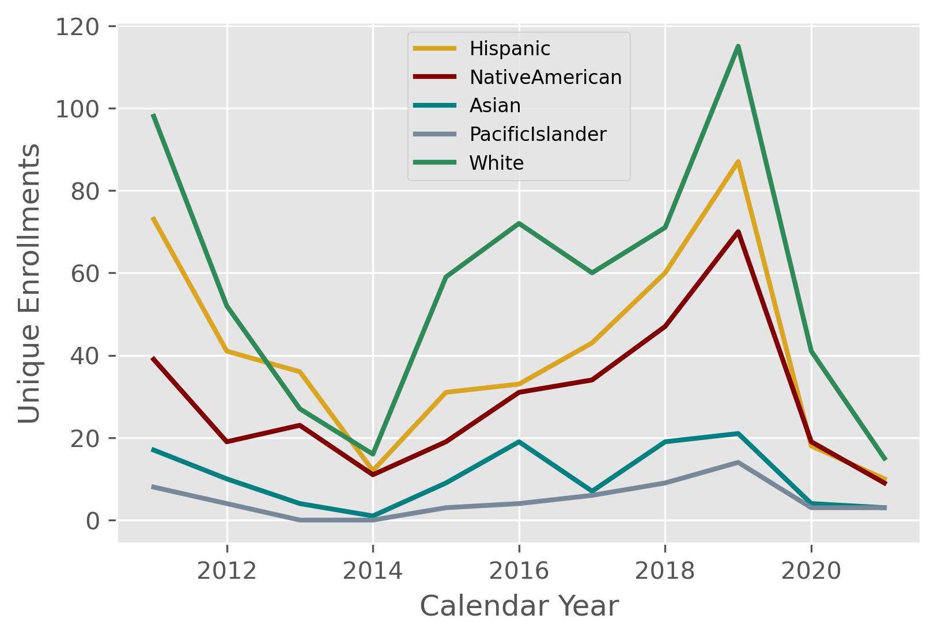
Enrollments by Race, Jan ’11 – Aug ’21
Because African American enrollments overwhelmingly outnumber enrollments from other races, chosen to display African American enrollments separately here
For example, in 2011 African American enrollments were 2581, while for the next highest race category, White, they were 98
Enrollments for each racial group track a similar trend to overall
enrollments, likely to due to internal (agency) factors, and
external macroeconomic factors

Slide 14
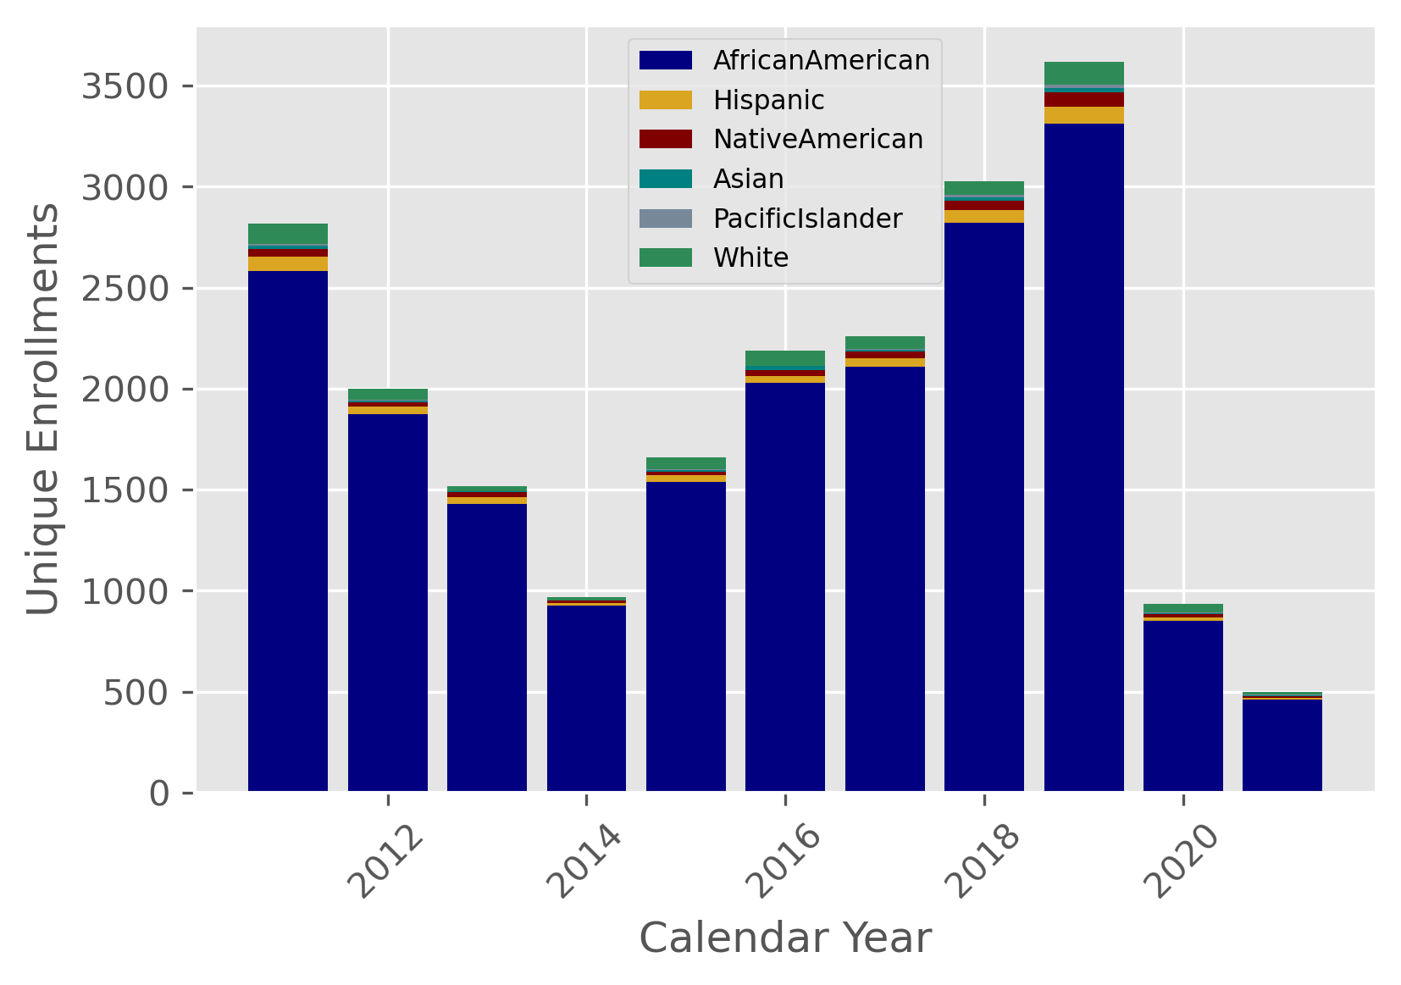
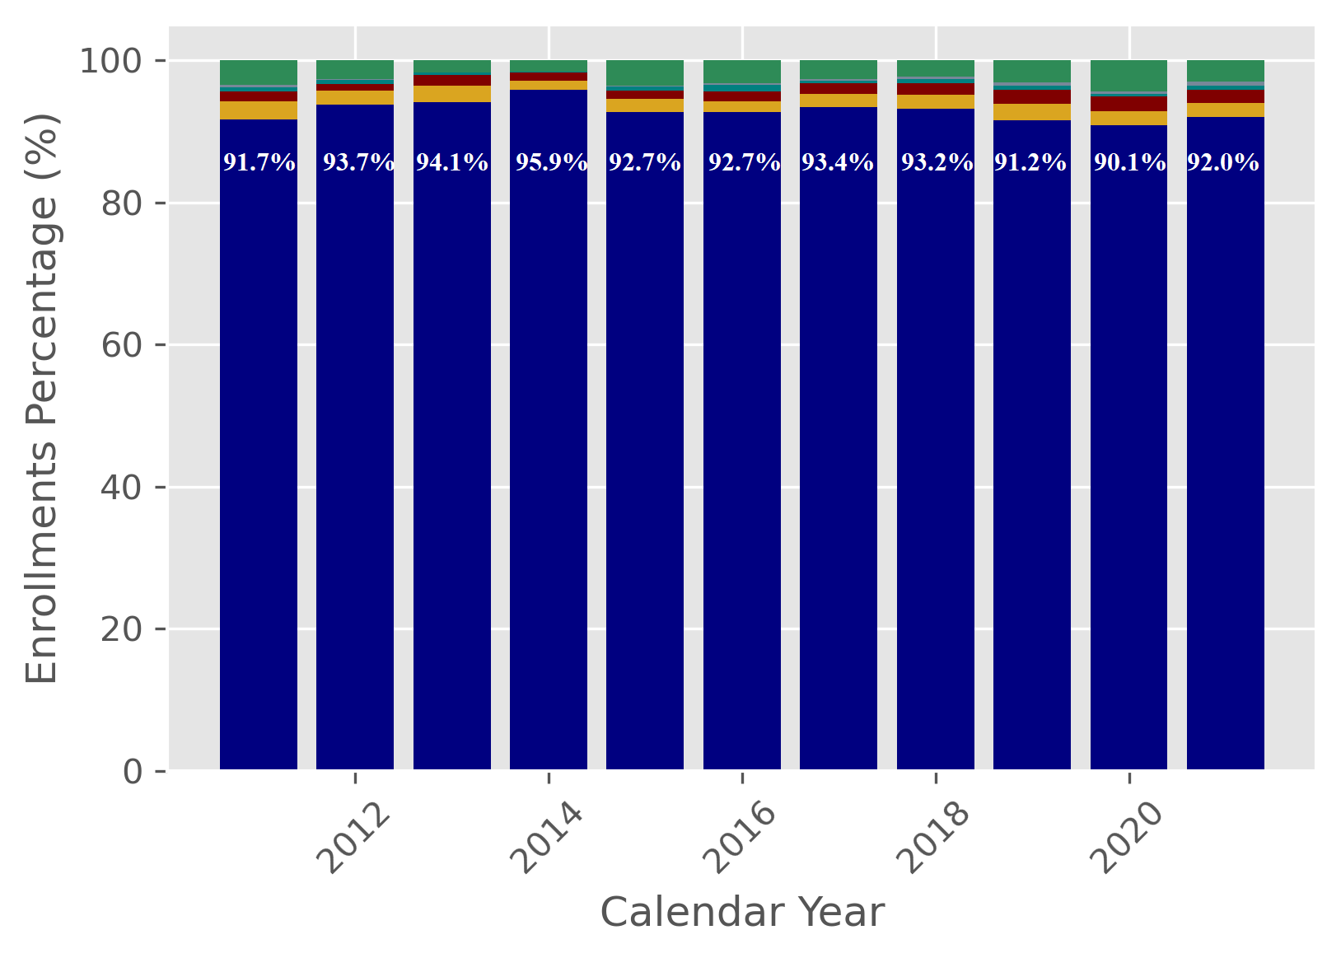
Enrollments by Race, Jan ’11 – Aug ’21
The above graphs provide some additional insight into the racial composition of enrollees when stacked together

Slide 15
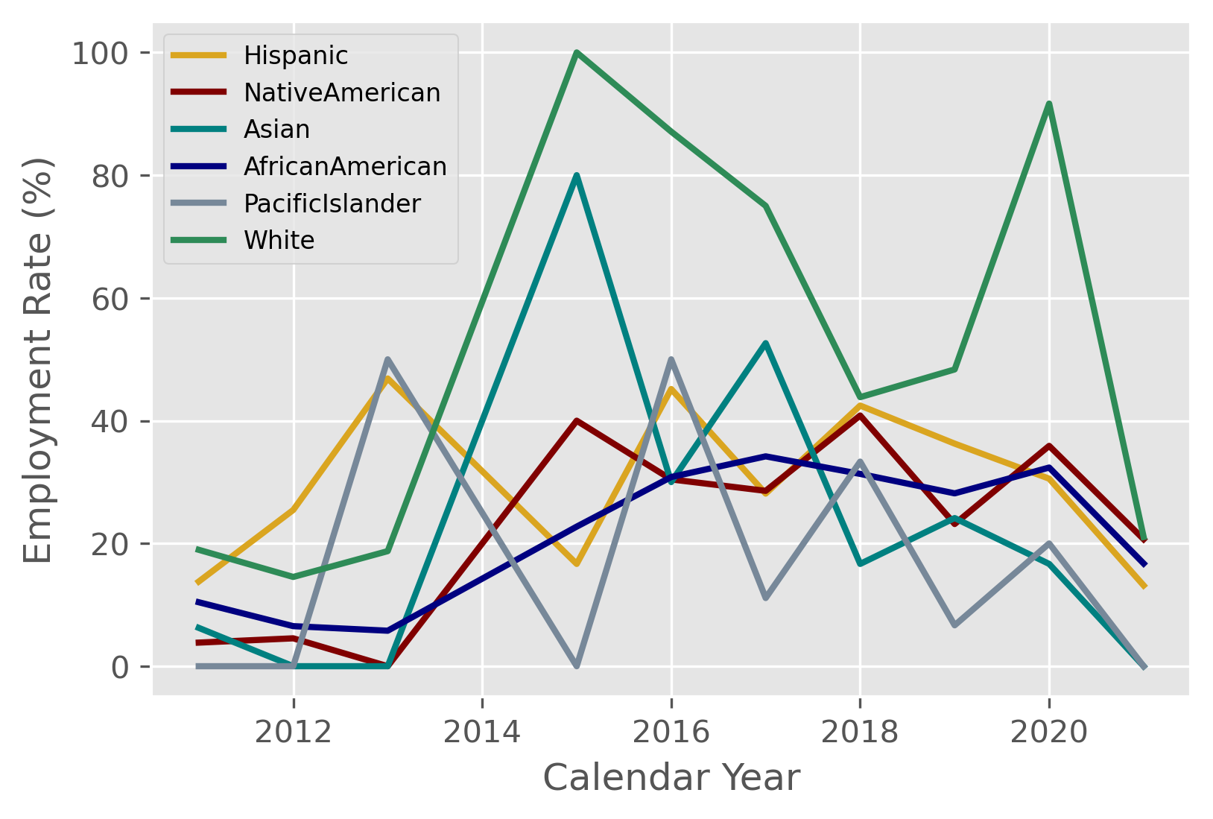
Employment by Race, Jan ’11 - Aug ’21
While African Americans enroll in the highest numbers, Whites and Asians are more successful in obtaining employment
Employment rates for Whites and Asians, occasionally exceed 40-60%
Those for African Americans remain below 35%
However, less volatility in African American employment rate, promising upward trend

Slide 16
Analogy: Speedboat vs. A Ship
Let African Americans represent a massive ships, while Whites and Asians represent nimble speedboats, with quicker turnaround times
It is easy to see how catering to a smaller audience can be achieved more easily, than creating customized solutions within a broader group

Slide 17
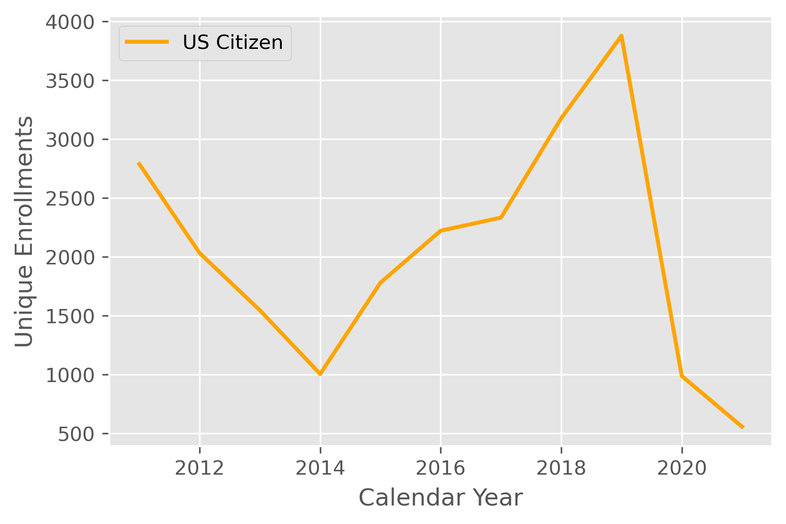
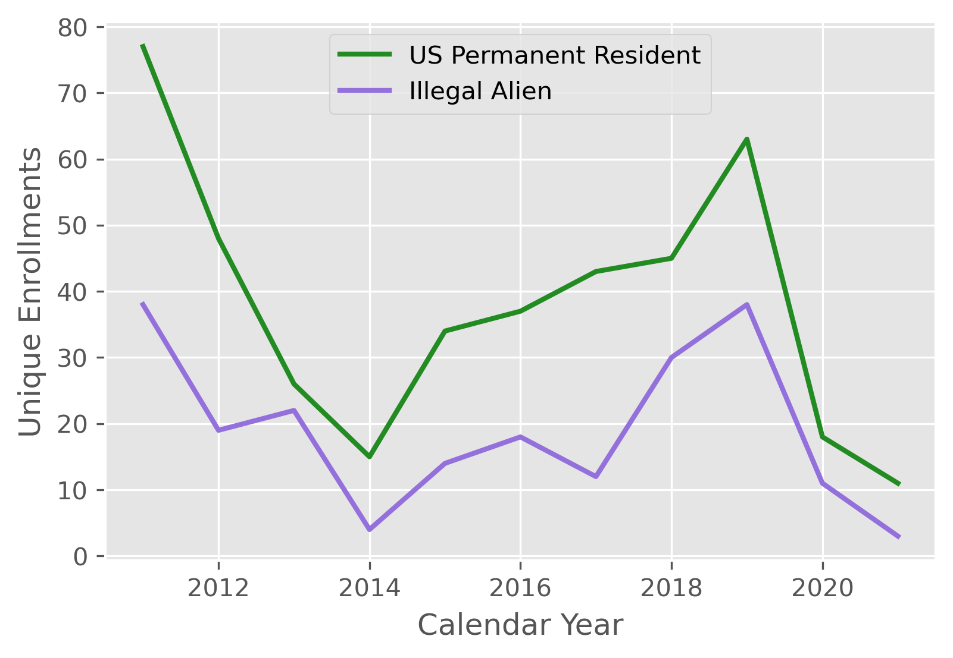
Enrollment by Citizenship, Jan ’11-Aug ’21
US Citizens constitute the largest group size of those enrolling in local programs
The following are the categories used to enroll new participants:
- Citizen of U.S. or Territory
- US Permanent Resident
- Alien/Refugee Lawfully Admitted to US

Slide 18
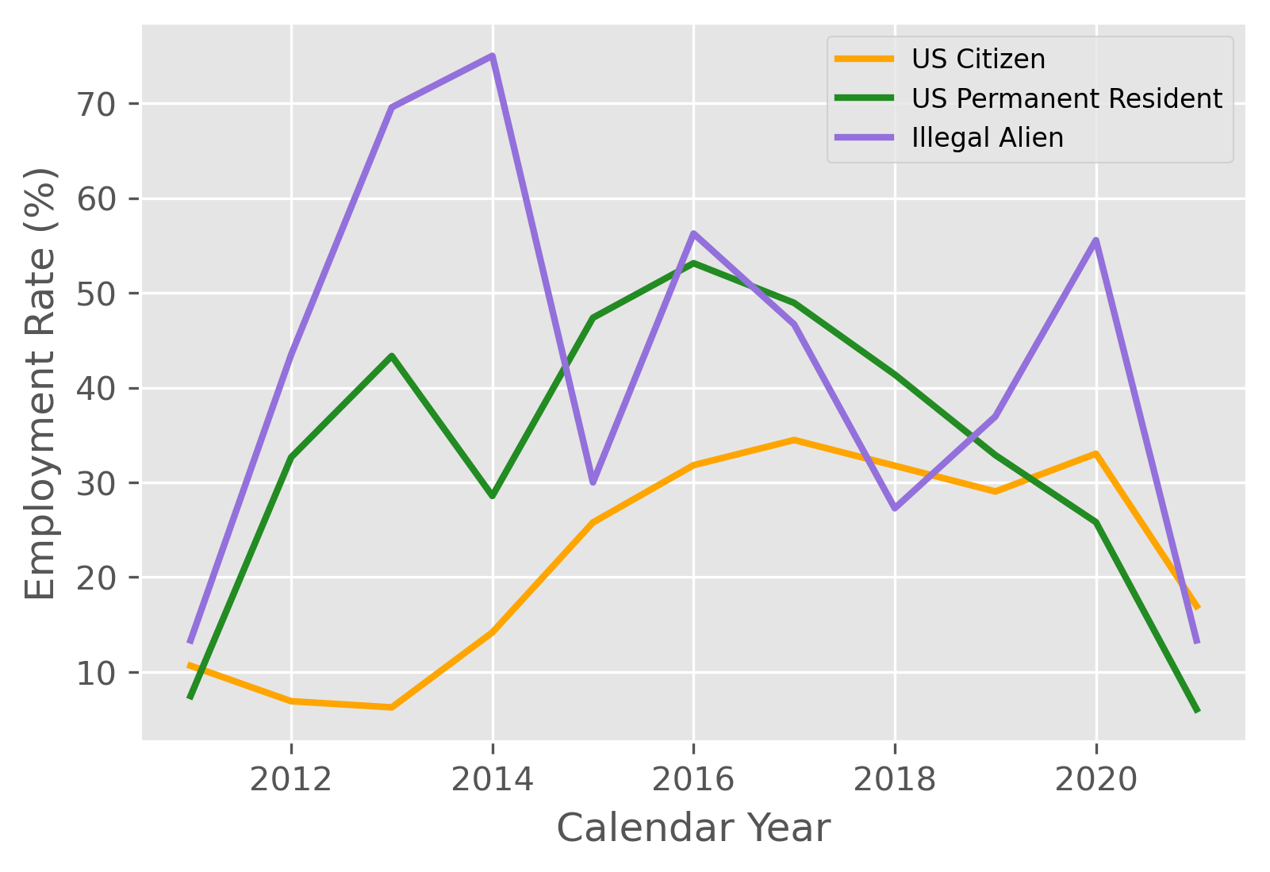
Employment by Citizenship, Jan ’11-Aug ’21
Much like with race, smaller categories achieve a higher success rate in obtaining employment
Similar to the largest race category, US Citizens show less
volatility, and a promising overall trend of increasing
employment rates

Slide 19
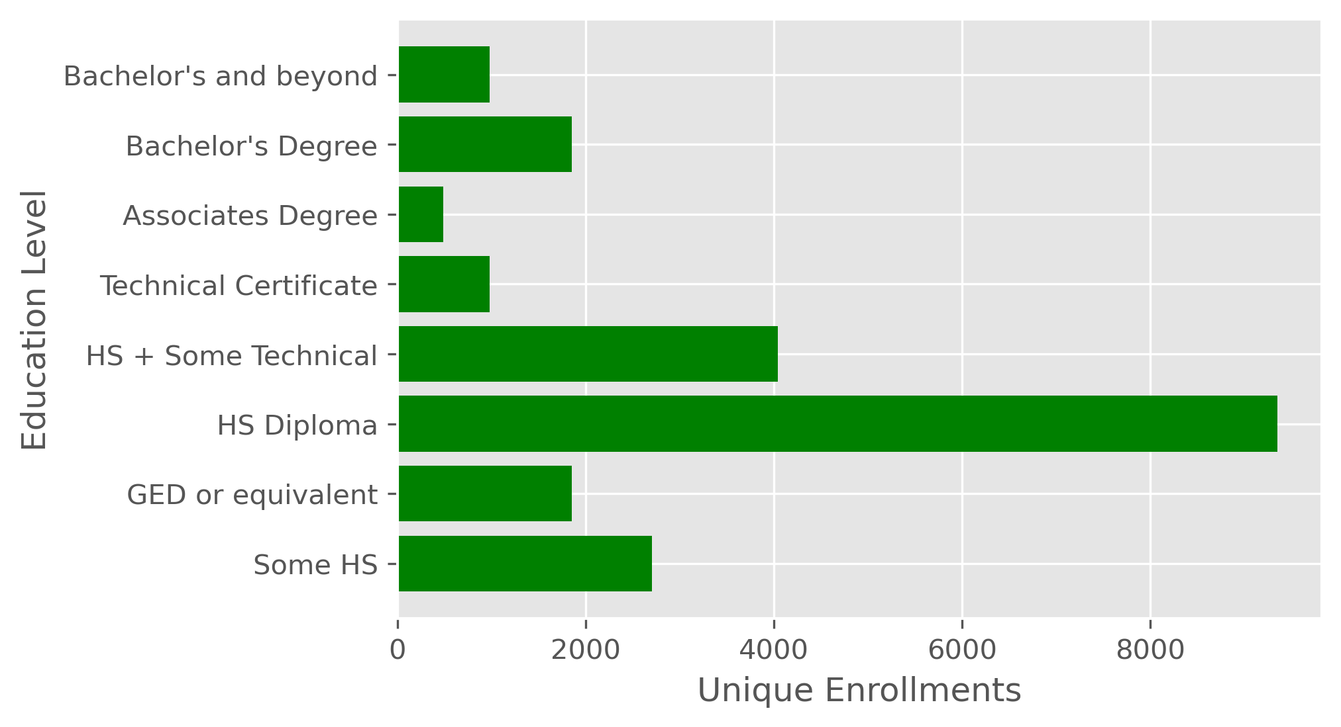
Enrollment by Education, Jan ’11-Aug ’21
Enrollment is highest for individuals with a High School diploma (9,356)
Most enrollees have between some high school to
some technical training

Slide 20
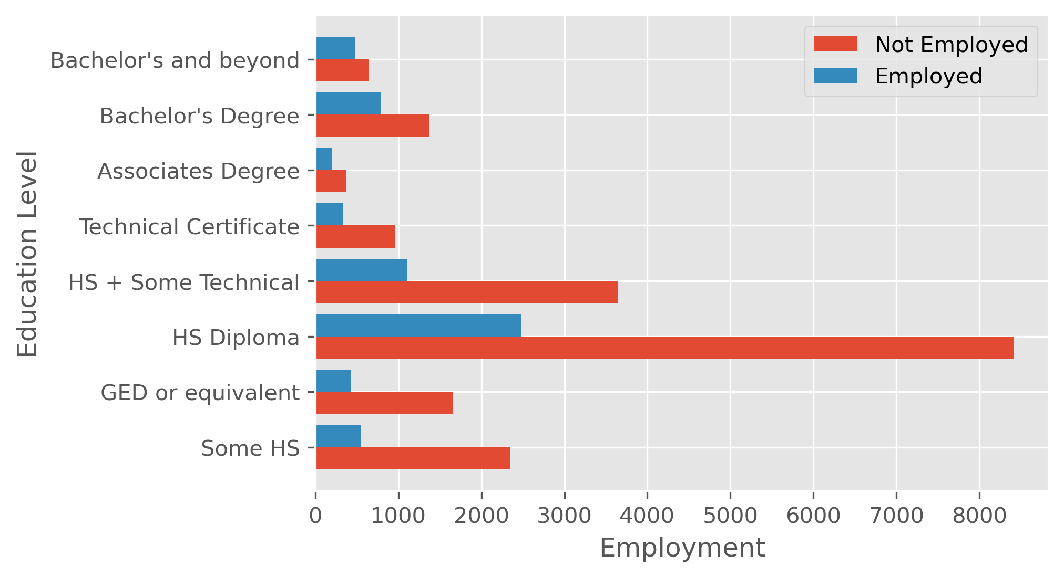
Employment by Education, Jan ’11-Aug ’21
Participants with an Associates degree or beyond have the highest success rates (34%+)
The largest category, those with a high school diploma, leaves room for further research into drivers of success
‘Some high school’ has the lowest success rate (18.9%)

Slide 21
Conclusion
Key Takeaways
Employment rates of 25% are standard, and anything above 40% is worth counting as a success
Employment rates for largest groups – US Citizens, African Americans – are increasing over time
Higher education levels are directly correlated with success obtaining employment
Age is inversely correlated with
obtaining employment

Slide 22
Next Steps
This is a foundation for creating a correlational study using additional variables such as length of participation, credentials earned, program participation
The final stage is to create a model based on characteristics and program participation to predict success in getting employed
Future Expansions include:
Chloropleth: breakouts by zipcode, and map visualization
All programs: federal and local

Slide 23
Q&A
Any questions, comments, ideas, suggestions?

Slide 24
Appendix 1: List of Local Programs
• Transitional Employment Program (TEP)
• DC Career Connections (DCCC)
• Back to Work 50+ (ended in FY19 Q4)
• DC Infrastructure Academy (DCIA, began 2018)
• Learn Earn Advance Prosper (LEAP)
• Fire and Emergency Medical Services (FEMS, WIOA, MOU)
• Metropolitan Police Department (MPD , WIOA, MOU)
• Pre-Apprenticeship

Slide 25
Appendix 2: Glossary
WIOA: Workforce Innovation and Opportunity Act
MOU: Memorandum of Understanding
CY: Calendar Year

Slide 26
Acknowledgements
Heather McGowan, for review and feedback
Works Cited: Local Jobs Training Report, Katrina Mathews

